Slide 1
OUR SOFTWARE TO R1
How We will organize, connect, test, and safely deploy our trained policy
Cesar A. Pascal Vasquez
R1 | 1
Notes:
In this presentation, We will explain how We plan to move our trained MuJoCo policy onto the physical Unitree R1. We will focus on the folders We need, the hardware connections, the runtime software, and the order in which We will test everything.
[Sources]
- Local Manual 3 and Manual 4 project documentation.
[/Sources]

Slide 2
To move our policy to R1, We need four new layers.
1
We will use Unitree SDK2 for the arms and BrainCo ROS 2 for the hands.
2
We will measure the real ball and palm instead of reading MuJoCo state.
3
We will preserve the exact observation and action ordering used in training.
4
We will enforce motion limits, stale-data checks, a watchdog, and an emergency stop.
OUR TRAINED .NPZ STAYS; We REPLACE SIMULATED INPUTS AND OUTPUTS
R1 | 2
Notes:
Our neural network does not need direct motor access. We will keep the trained NPZ policy and build four supporting layers around it: hardware drivers, perception, data adapters, and an independent safety layer.
[Sources]
- Local Manual 3 and Manual 4 observation/action definitions.
[/Sources]

Slide 3
We will organize our deployment code into seven folders.
• config/ — joint maps, limits, calibration, and policy settings.
• policies/ — trained .npz files and version information.
• interfaces/ — R1, Revo2, and camera drivers.
• runtime/ — observation adapter, policy runner, and action mapper.
• safety/ — command limits, watchdog, and emergency stop.
• launch/ — observe, shadow, simulated, and hardware entry points.
• logs/ + tests/ — recorded runs and automatic checks.
We WILL KEEP TRAINING CODE SEPARATE FROM DEPLOYMENT CODE
R1 | 3
Notes:
We will create one deployment project and keep each responsibility in a separate folder. This will let me test the robot interfaces without changing the trained model, and it will keep safety code outside the neural policy.
[Sources]
- Folder structure is our proposed implementation architecture based on the local policy code and vendor interfaces.
[/Sources]

Slide 4
We will give each folder one clear responsibility.
CONFIG + POLICY
RUNTIME + SAFETY
config/joint_map.yaml
config/limits.yaml
config/camera.yaml
policies/manual3.npz
runtime/observe.py
runtime/policy_runner.py
safety/filter.py
safety/watchdog.py
INTERFACES
interfaces/r1_arm.py
interfaces/revo2_hand.py
interfaces/ball_camera.py
OUR FILES DEFINE DATA → OUR INTERFACES CONNECT → OUR RUNTIME EXECUTES
R1 | 4
Notes:
Our configuration files will define the joint map, limits, calibration, and policy path. Our interface files will communicate with the R1, Revo2 hands, and camera. Our runtime and safety files will build observations, run the policy, filter commands, and stop the system when necessary.
[Sources]
- Local Manual 3 and Manual 4 code organization.
[/Sources]

Slide 5
We will connect three data paths to one control computer.
R1 NETWORK
RGB-D CAMERA
We connect R1 Ethernet
Use the SDK2 DDS interface
Read joint state
Send arm targets
We connect an RGB-D camera
Publish a timestamped
ball pose in the
R1 base frame
REVO2 BUS
We connect the hands by
USB-RS485, CAN FD,
or EtherCAT
Use BrainCo ROS 2
OUR UBUNTU / ROS 2 COMPUTER SYNCHRONIZES ALL THREE STREAMS
R1 | 5
Notes:
We will use one Ubuntu and ROS 2 computer to synchronize three streams. The R1 will connect over Ethernet through SDK2. The Revo2 hands will use their supported hardware bus and ROS 2 driver. The RGB-D camera will provide the ball pose in the R1 base coordinate frame.
[Sources]
- https://github.com/unitreerobotics/unitree_sdk2/blob/main/example/r1/high_level/r1_arm_sdk_dds_example.cpp
- https://github.com/BrainCoTech/brainco_hand_ros2
[/Sources]

Slide 6
Our control loop will repeat every 25 milliseconds.
We READ STATE
We SEND TARGETS
R1 joint feedback
Revo2 finger state
Ball pose + velocity
Task phase + last action
Map normalized action
Clamp angle + speed
Publish arm + hand
Stop on stale data
We RUN POLICY
Build 51/94 values
Normalize exactly
Run .npz network
Produce 11/22 actions
READ → BUILD OBSERVATION → INFER → FILTER → COMMAND
R1 | 6
Notes:
Every 25 milliseconds, We will read the robot, hand, camera, task-phase, and previous-action data. We will build the same 51- or 94-value observation used in training, run the NPZ policy, apply the safety filter, and then publish bounded targets.
[Sources]
- Local Manual 3: 51 observations, 11 actions, 40 Hz.
- Local Manual 4: 94 observations, 22 actions, 40 Hz.
[/Sources]

Slide 7
We will prepare the computer before loading our policy.
1
We will install Ubuntu 22.04 and ROS 2 Humble on our control computer.
2
We will build Unitree SDK2, read R1 state, and run the arm example.
3
We will build the BrainCo workspace and test each hand independently.
4
We will add camera tracking, save calibration, and verify every joint map.
We WILL LOAD OUR POLICY ONLY AFTER MANUAL CONTROL AND FEEDBACK WORK
R1 | 7
Notes:
Before We load the neural policy, We will prove that We can read and command every subsystem manually. We will test the R1 arms, then each Revo2 hand, then the camera and calibration. This prevents a software mapping error from becoming an unsafe robot motion.
[Sources]
- https://github.com/unitreerobotics/unitree_sdk2
- https://github.com/BrainCoTech/brainco_hand_ros2
[/Sources]

Slide 8
We will use four launch modes before hardware control.
1
observe: We read and log sensors; We send no commands.
2
shadow: We run our policy and record targets without moving.
3
simulated: We use real sensor data to drive the MuJoCo robot.
4
hardware: We use a supported R1 with reduced limits and no throw.
We WILL ADVANCE ONLY WHEN THE PREVIOUS MODE PASSES
R1 | 8
Notes:
We will not switch directly from simulation to full motion. In observe mode We only inspect sensors. In shadow mode We run the policy without movement. In simulated mode real sensor data drives MuJoCo. Only after those modes pass will We enable reduced hardware motion.
[Sources]
- Staged commissioning workflow derived from the official SDK examples and local policy constraints.
[/Sources]

Slide 9
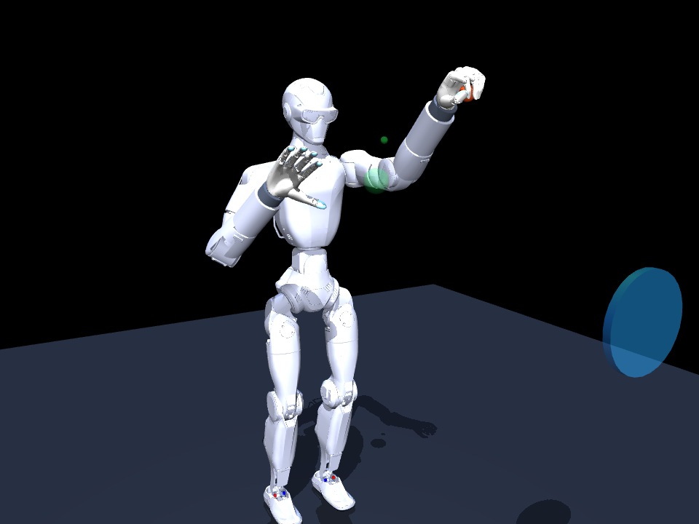
Our first real test: one arm, one soft ball, no throw.
We will use Manual 3 with the R1 mechanically supported. We will keep the balance controller active and cap joint range, speed, acceleration, and policy residuals.
We will pass each step in order: hold pose → neutral pose → slow reach → grasp → lift 5 cm → return.
We will keep an operator at the emergency stop; our safety filter has final authority
R1 | 9
Notes:
Our first physical objective is intentionally small. We will use the single-arm Manual 3 policy, mechanically support the R1, disable throwing, and test one step at a time. We will only continue after each earlier step succeeds repeatedly.
[Sources]
- Local Manual 3 fixed-pelvis task definition.
- Existing simulation image retained from the source deck.
[/Sources]

Slide 10
Sources We used
Unitree Robotics. R1 high-level arm SDK example.
https://github.com/unitreerobotics/unitree_sdk2/blob/main/example/r1/high_level/r1_arm_sdk_dds_example.cpp
Unitree Robotics. Unitree MuJoCo simulator.
https://github.com/unitreerobotics/unitree_mujoco
BrainCoTech. BrainCo Revo2 ROS 2 integration.
https://github.com/BrainCoTech/brainco_hand_ros2
BrainCoTech. Revo2 hardware-driver documentation.
https://github.com/BrainCoTech/brainco_hand_ros2/blob/master/brainco_hardware/brainco_hand_driver/README.md
Applied and Embodied AI Lab. Manual 3 and Manual 4 local project documentation.
R1 | 10
Notes:
These are the official Unitree and BrainCo resources We used, together with our Manual 3 and Manual 4 project documentation.
[Sources]
- https://github.com/unitreerobotics/unitree_sdk2/blob/main/example/r1/high_level/r1_arm_sdk_dds_example.cpp
- https://github.com/unitreerobotics/unitree_mujoco
- https://github.com/BrainCoTech/brainco_hand_ros2
- https://github.com/BrainCoTech/brainco_hand_ros2/blob/master/brainco_hardware/brainco_hand_driver/README.md
- Local Manual 3 and Manual 4 project documentation.
[/Sources]

